Slide 1

Progress Presentation
Summer Cohort
August 2026

Slide 2
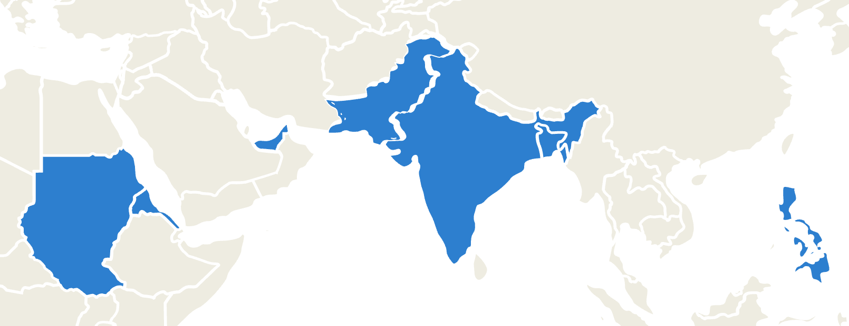
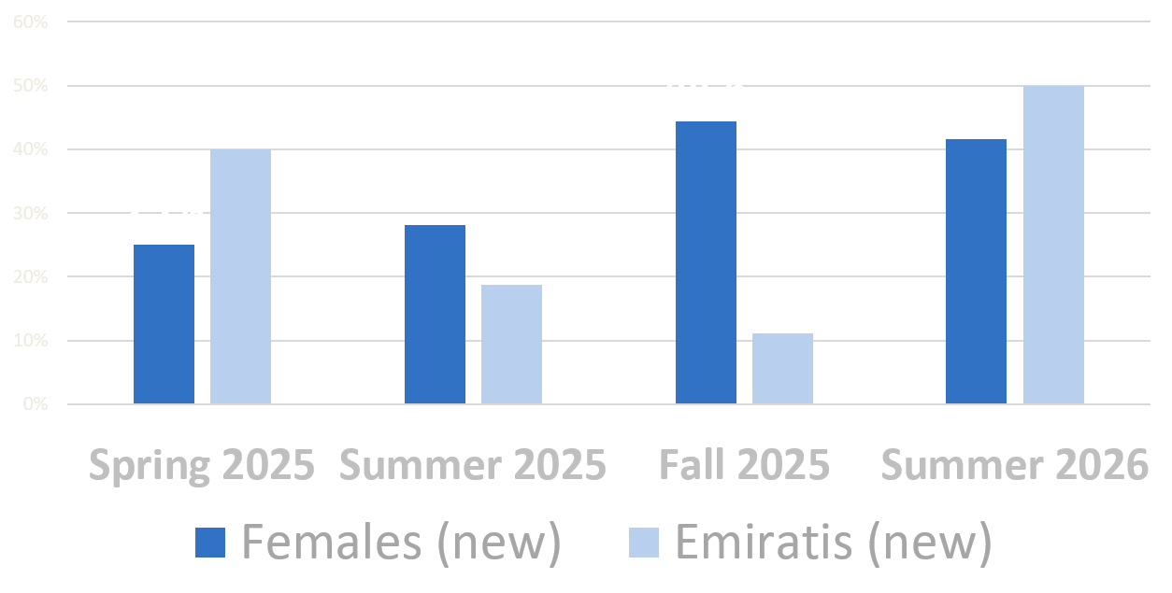
Our Team of Innovators
About 50% of our new interns are pursuing, or have completed their MSc.
A Glance at the CISS Team
Our team consists of 7 nationalities from around the world.
This cohort brings a combined 2,290 hours of volunteering experience.

Slide 3










Universities

Slide 4


Universities

Slide 5



























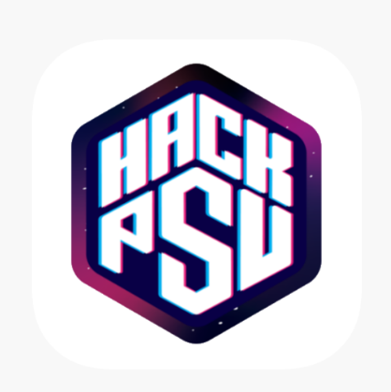


Experiences
and many more …

Slide 6
Team Structure
GAIT

Slide 8
ModSim

Slide 9
AI for Operations

Slide 10
1LMX (?)

Slide 11
RSA

Slide 12
Systems Engineering

